Slide 1
Cross Domain
Accessing SharePoint from outside SharePoint
Programming with the Cross-Domain Library

Slide 2
Accessing SharePoint from outside SharePoint

Slide 3
Cross Domain Library
Same-domain policy prevents JavaScript from making direct calls to either the app web or host web from the remote web
Required to make JavaScript calls to both the app web and host web
Notes:
Makes it possible to call the app web or host web from JavaScript in the remote web

Slide 4
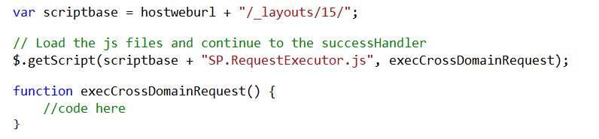
Loading the Cross-Domain Library
SP.RequestExecutor.js located in LAYOUTS directory
Option 1: Copy and include directly in your app
Option 2: Load Dynamically using jQuery
Notes:
You’ll also need
Sp.runtime.js
Sp.js
MicrosoftAjax.js

Slide 5
Cross-Domain Library Architecture
Web Page
IFRAME
App Web
AppWebProxy.aspx
SP.RequestExecutor.js
AppWebProxy.aspx
Remote Web
SharePoint
Notes:
The remote web loads the SPRequestExecutor.js library
The remote web create a new SP.RequestExecutor object, initializing it with the URL of the app web
This causes a hidden IFRAME to be created, which loads APPWebProxy.aspx from the LAYOUTS directory
The SP.RequestExecutor object uses the HTML5 postmessage command to send requests from the remote web
The request is executed by the AppWebProxy.aspx page
The response is returned

Slide 6
Lab #3 – Exercise 2 Task 1

Slide 7
Programming Cross-Domain Library

Slide 8
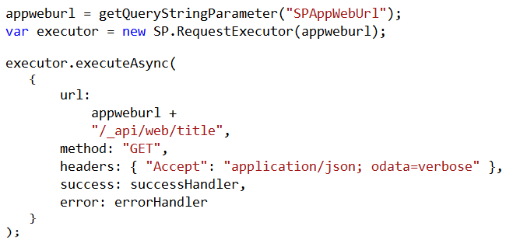
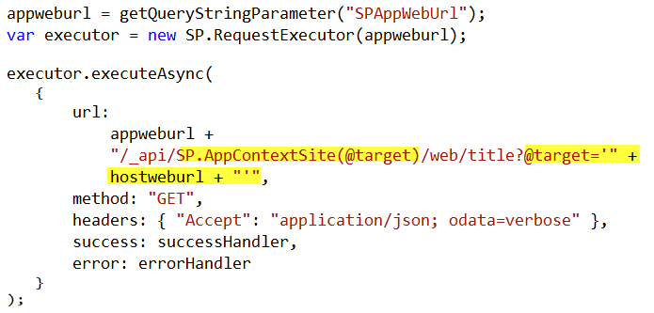
Cross-Domain REST Calls
Call targeting App Web
Call targeting Host Web
Notes:
When calling the host web, you must switch the context

Slide 9
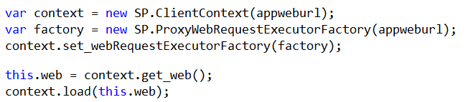
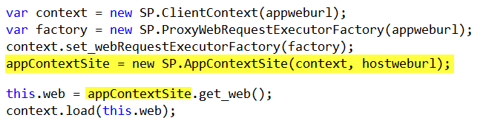
Cross-Domain CSOM Calls
Call targeting App Web
Call targeting Host Web
Notes:
When calling the host web, you must switch the context

Slide 10
Lab #3 – Exercise 2 Task 2

Slide 11

Summary
Introduction
Programming OAuth
Programming Cross-Domain Library

Slide 12

© 2012 Microsoft Corporation. All rights reserved. Microsoft, Windows, and other product names are or may be registered trademarks and/or trademarks in the U.S. and/or other countries.
The information herein is for informational purposes only and represents the current view of Microsoft Corporation as of the date of this presentation. Because Microsoft must respond to changing market conditions, it should not be interpreted to be a commitment on the part of Microsoft, and Microsoft cannot guarantee the accuracy of any information provided after the date of this presentation. MICROSOFT MAKES NO WARRANTIES, EXPRESS, IMPLIED OR STATUTORY, AS TO THE INFORMATION IN THIS PRESENTATION.

